Slide 1
Digital Alpha’s SEC filling Analyzer for SaaS Companies

Slide 2
EDGAR Dataset
EDGAR, the Electronic Data Gathering Analysis, and Retrieval system, performs automated collection, validation, indexing, acceptance, and forwarding of submissions by companies and others who are required by law to file forms with the U.S. Securities and Exchange Commission (SEC).

Slide 3
Our Approach
Data Scraping
Data Cleaning
Machine Learning
Serving
Scraping the fillings from SEC EDGAR dataset
Cleaning and preparing the data for use.
Applying sentiment analysis and fraud detection on the cleaned data.
Visualizing the data on a webapp.
1
2
3
4

Slide 4
Data Scraping

Slide 5
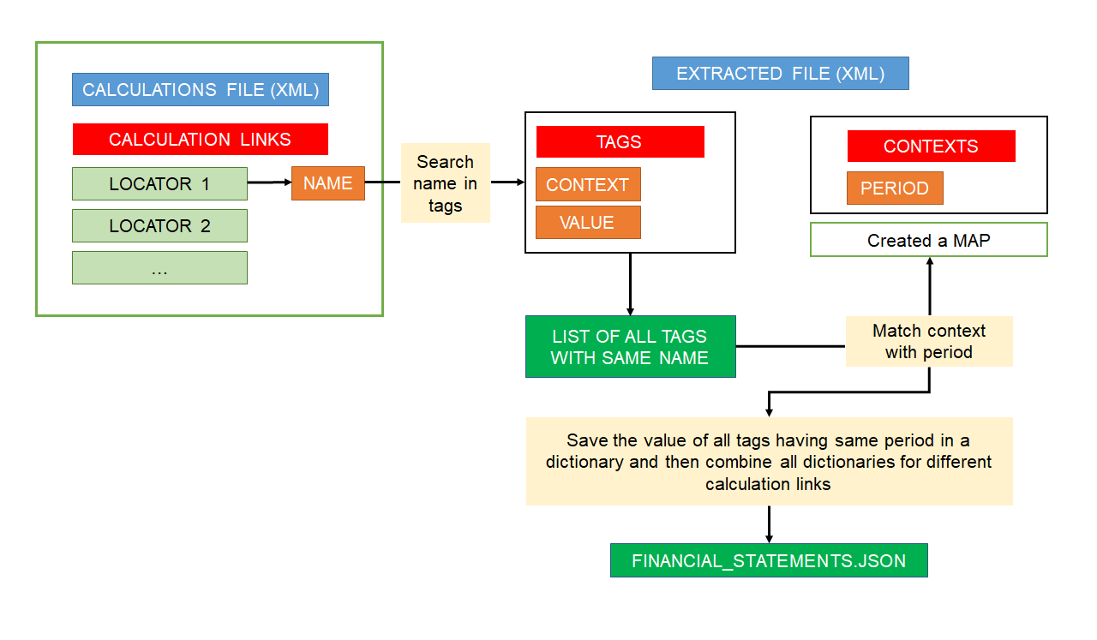
Data Scraping Workflow

Slide 6
Data Cleaning

Slide 7
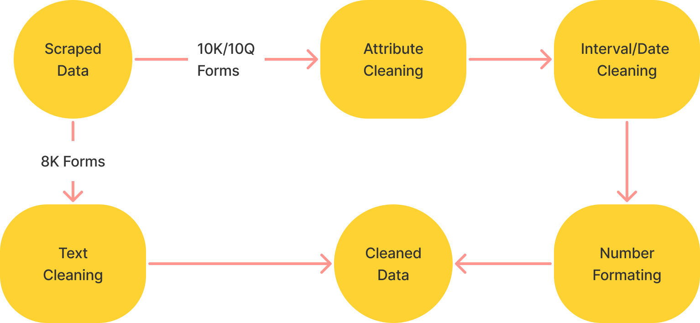
Data Cleaning and Preparation Workflow

Slide 8
Machine Learning

Slide 9
Implemented Modules
Fraud Detection
Using Random Forest
Outputs the probability that company has been doing fraud in its financial statements.
Sentiment Analysis
Using Loughran-McDonald Master Dictionary
Detects the financial sentiment of the financial statements(10K, 10Q, 8K)

Slide 10
Model | ROC AUC
Neural Network | 0.54
Random Forest | 0.58
XGB Classifier | 0.61
XGB Classifier (with smote) | 0.68

Slide 11
Why never Outdated?
The models presented above can be easily retrained with new data and hence can be updated to a newer and better version. The model retraining process is simple, as the models are hosted on G-Cloud running a single script with the new data will automatically train the model and it will be ready for predictions.

Slide 12
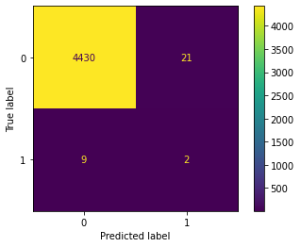



NN Model
XGB
Random Forest
XGB(With Smote)

Slide 13
Web Design

Slide 14
Frontend Architecture
Frontend for the web app is implemented using ReactJs and NextJs.
It utilizes the Material UI design paradigm.
For showing the visualizations, charts, etc. we used a library named ReCharts.

Slide 15
Backend Architecture
The backend is based on the OpenAPI 3.0 specification and is developed using an API First Approach.
Backend is implemented using ExpressJs framework and is developed using the OpenAPI code generator.
It uses the MongoDb database for storing the filling and other data.
The server also provides the Swagger Documentation for third-party companies to access the API.

Slide 16
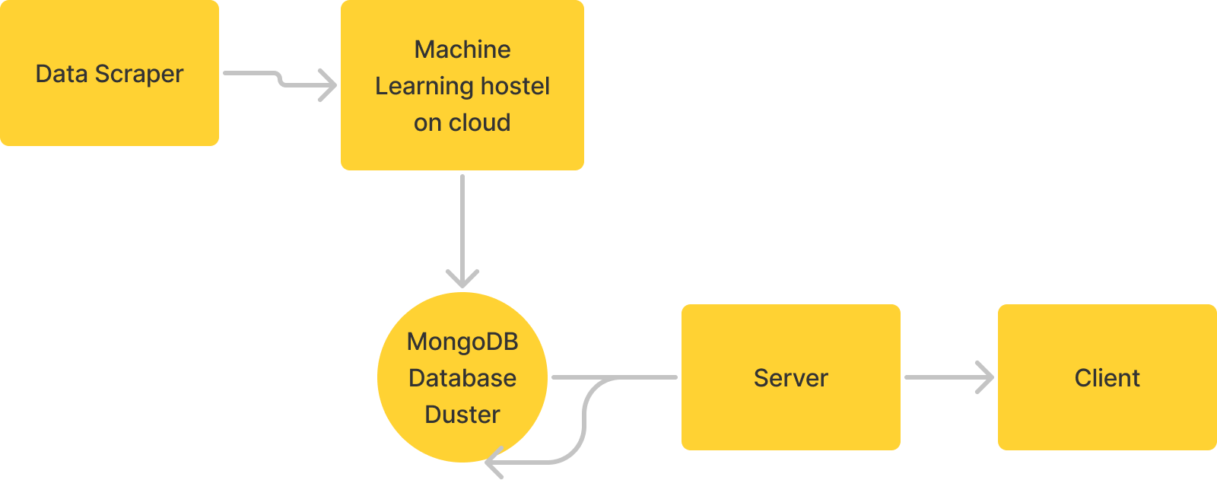
High Level Architecture

Slide 17
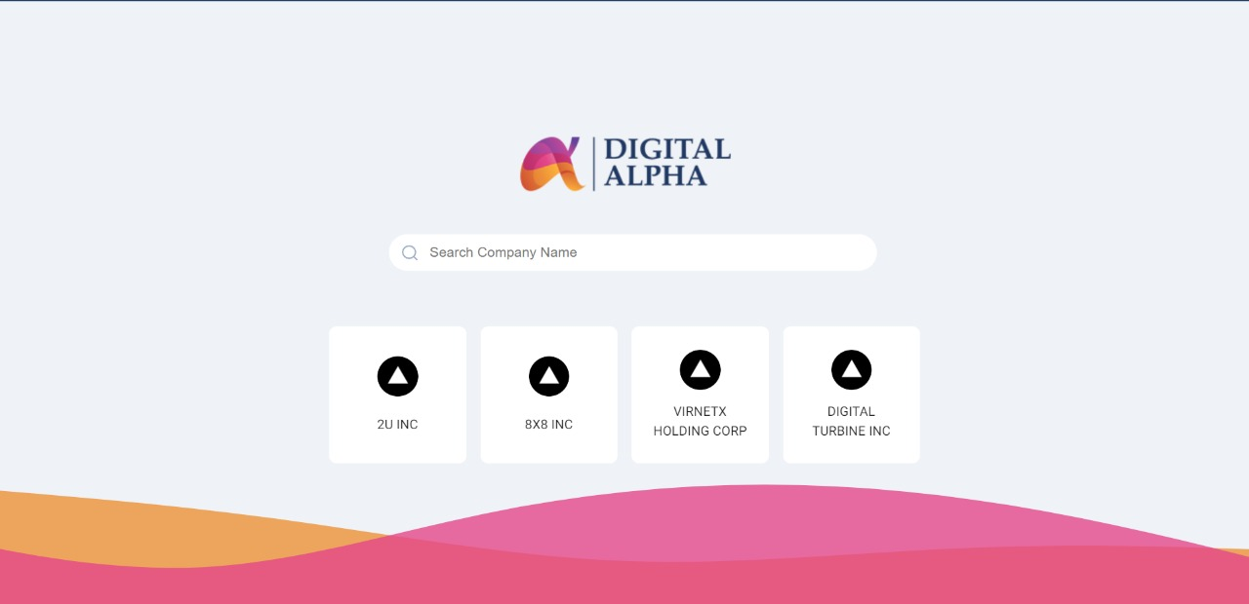

Slide 18
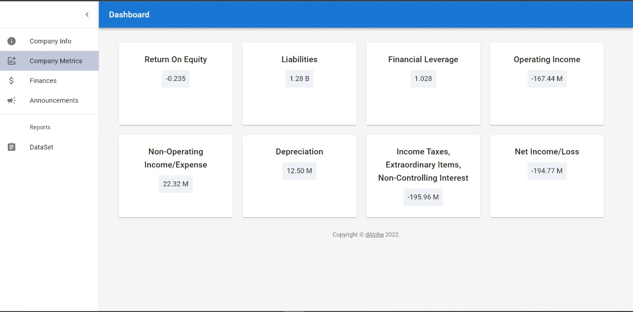

Slide 19
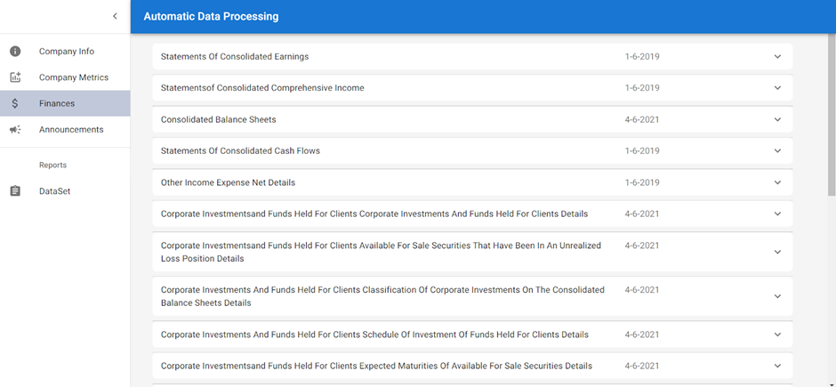

Slide 20
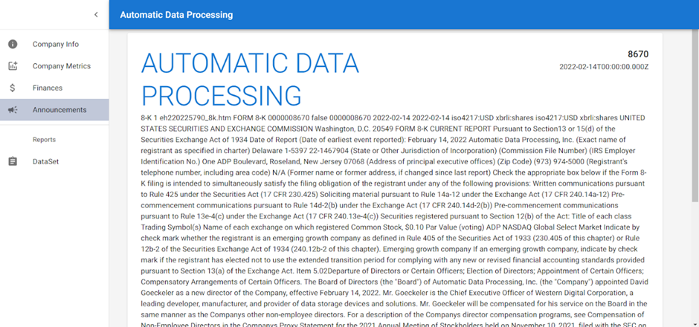

Slide 21
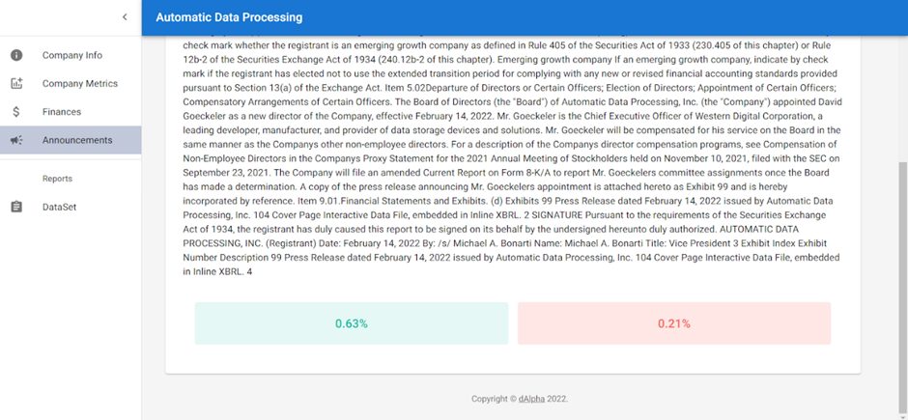

Slide 22
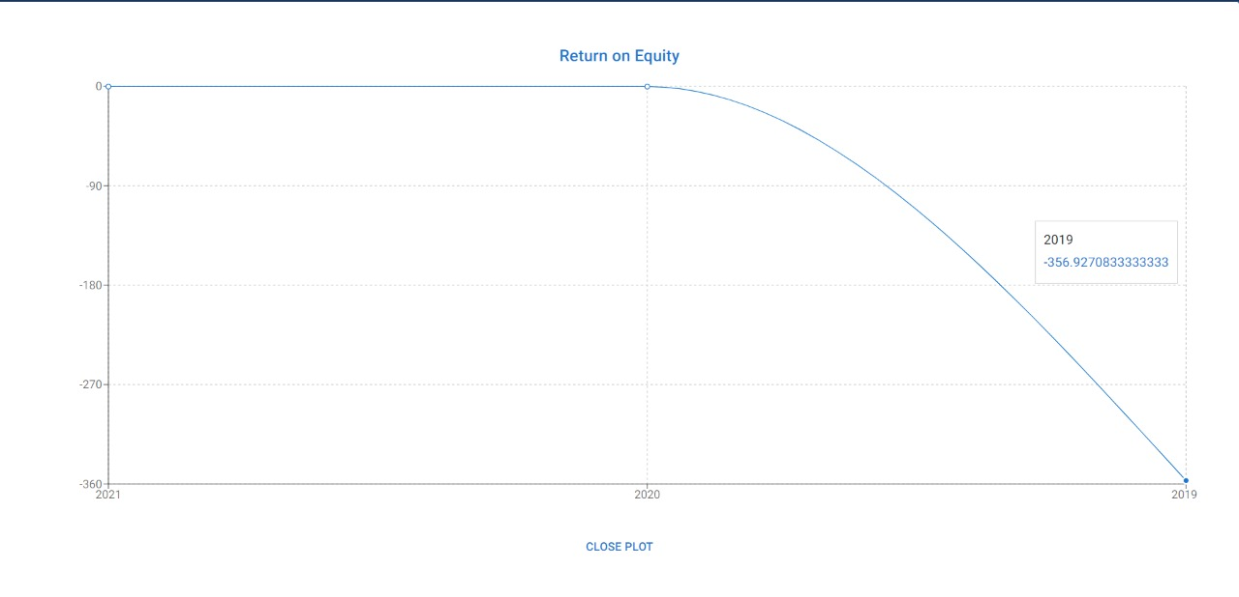

Slide 23
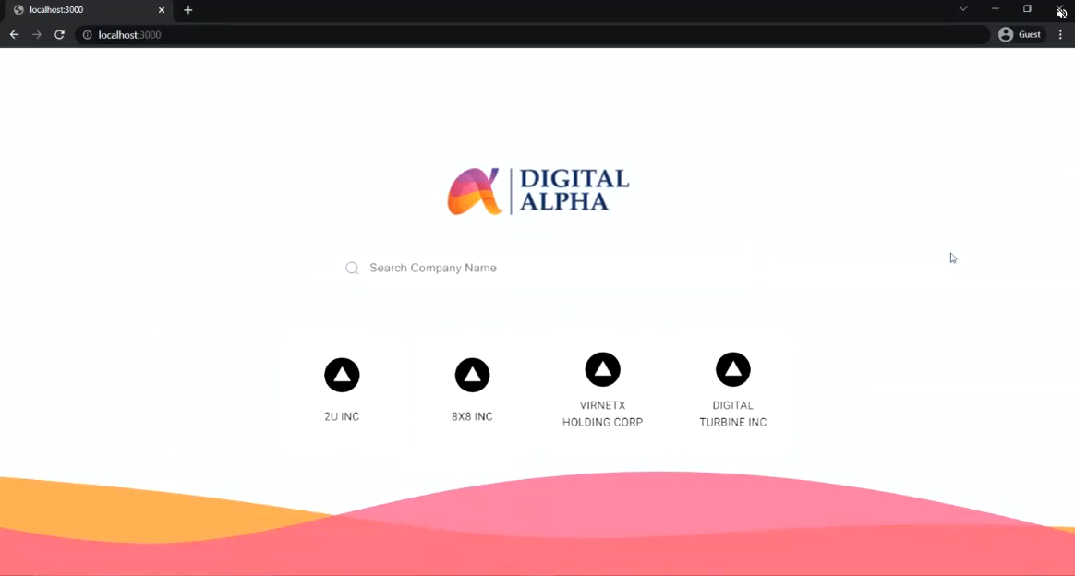

Slide 24
Thank You !

